Slide 1

AI IN EDUCATION:
Capital Flows & Higher Education Spending
TODAY’S SPEAKERS:
XI WANG
Energy Studies & Environmental Studies
CATHY WINEINGER
Political Science
MODERATED BY
AMITES SARKAR
Mathematics
Why is Microsoft spending millions to push its chatbots on Washington K12 schools while the state legislature cuts millions from Western’s Budget?

Slide 2
Please introduce yourself to your neighbors!
Name
Pronouns, if you want
What you do at WWU
How you heard about this event
Why you are here

Slide 3
Critical A.I. Literacies Collective
Who we are:
The Critical A.I. Literacies Collective (CALC) is a faculty and staff group working to learn and teach about the wide-ranging global impacts of corporate A.I. products from critical, interdisciplinary perspectives.
We approach this topic from a shared commitment to building life-affirming futures for all of us together on this planet. We are thinking beyond the unit of the individual to envision systemic impacts and possibilities.
Steering committee:
Aspen Clark (ITS), Robyn Dahl (Geology & SMATE), Jenny Forsythe (English), Claudia Johnson (Fairhaven College), Amites Sarkar (Mathematics), Emily Spracklin (Western Libraries), and Xi Wang (Energy Studies & Environmental Studies)
Read our full statement: https://tinyurl.com/calcstatement

Slide 4
Critical A.I. Literacies Collective (CALC) Winter 2026 Teach-In: “A.I. in Education: Capital Flows and Higher Ed Spending” – A.I. and Capital Flows February 2, 2026
Xi Wang, PhD
Department of Environmental Studies Institute for Energy Studies Western Washington University

Slide 5
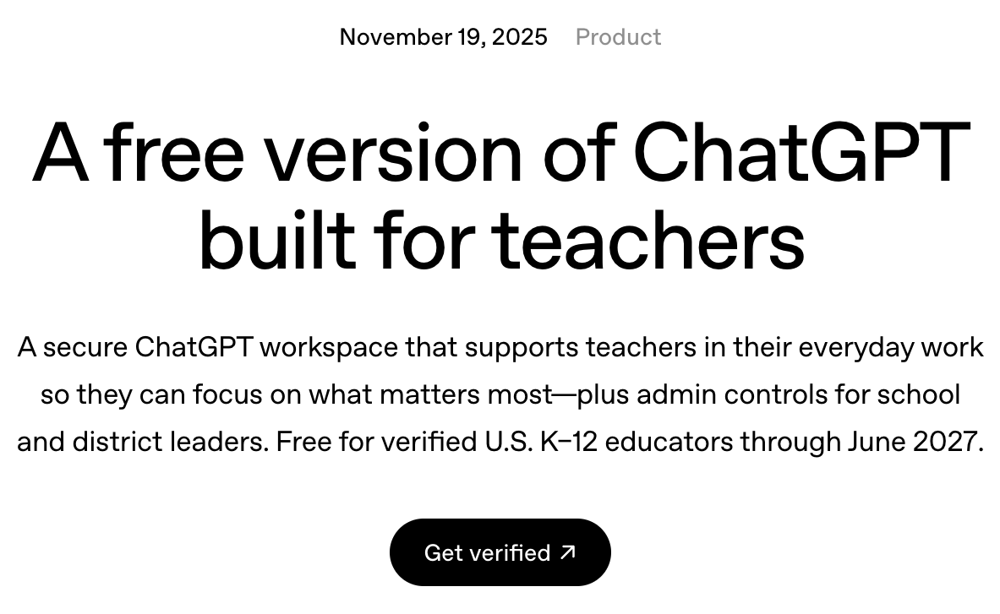
How can GenAI service us?
OpenAI

Slide 6
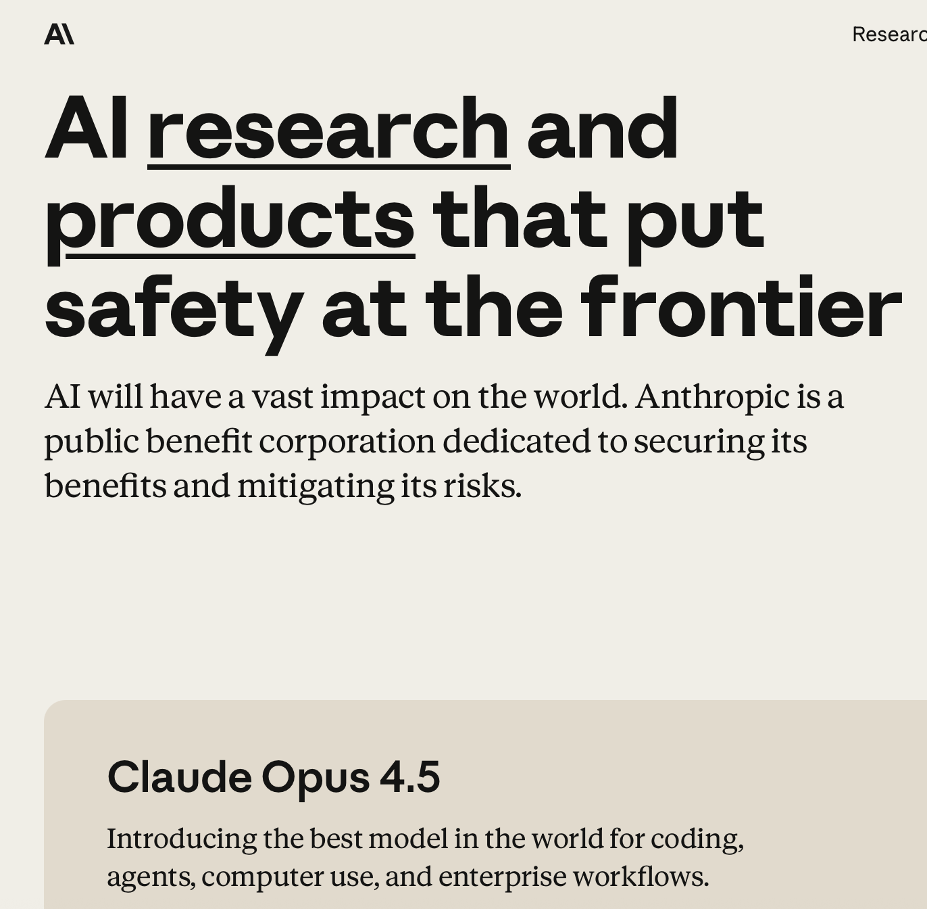
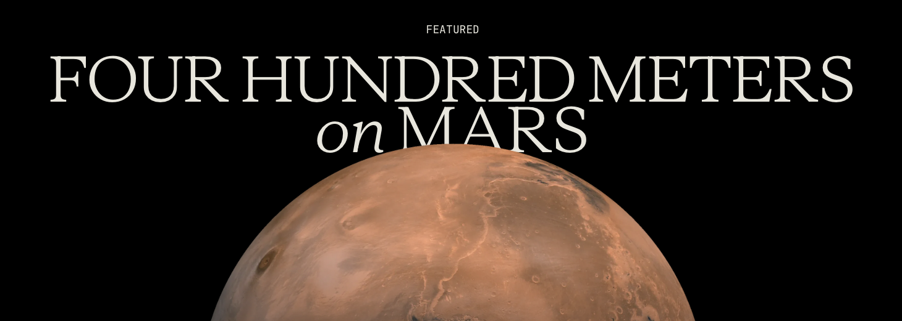
How can GenAI service us?
OpenAI
Anthropic

Slide 7
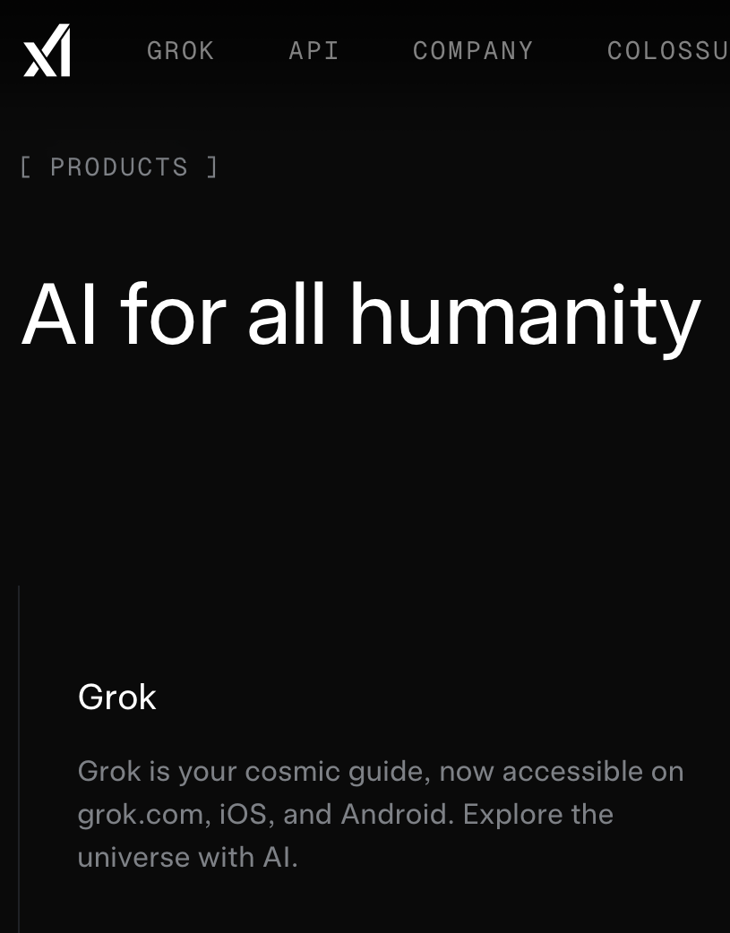
How can GenAI service us?
OpenAI
Anthropic
xAI
Sources: OpenAI (2025, Nov 19). ChatGPT for teachers. https://openai.com/index/chatgpt-for-teachers/; Anthropic (2026). Home. https://www.anthropic.com; xAI (2026). Home. https://x.ai/

Slide 8
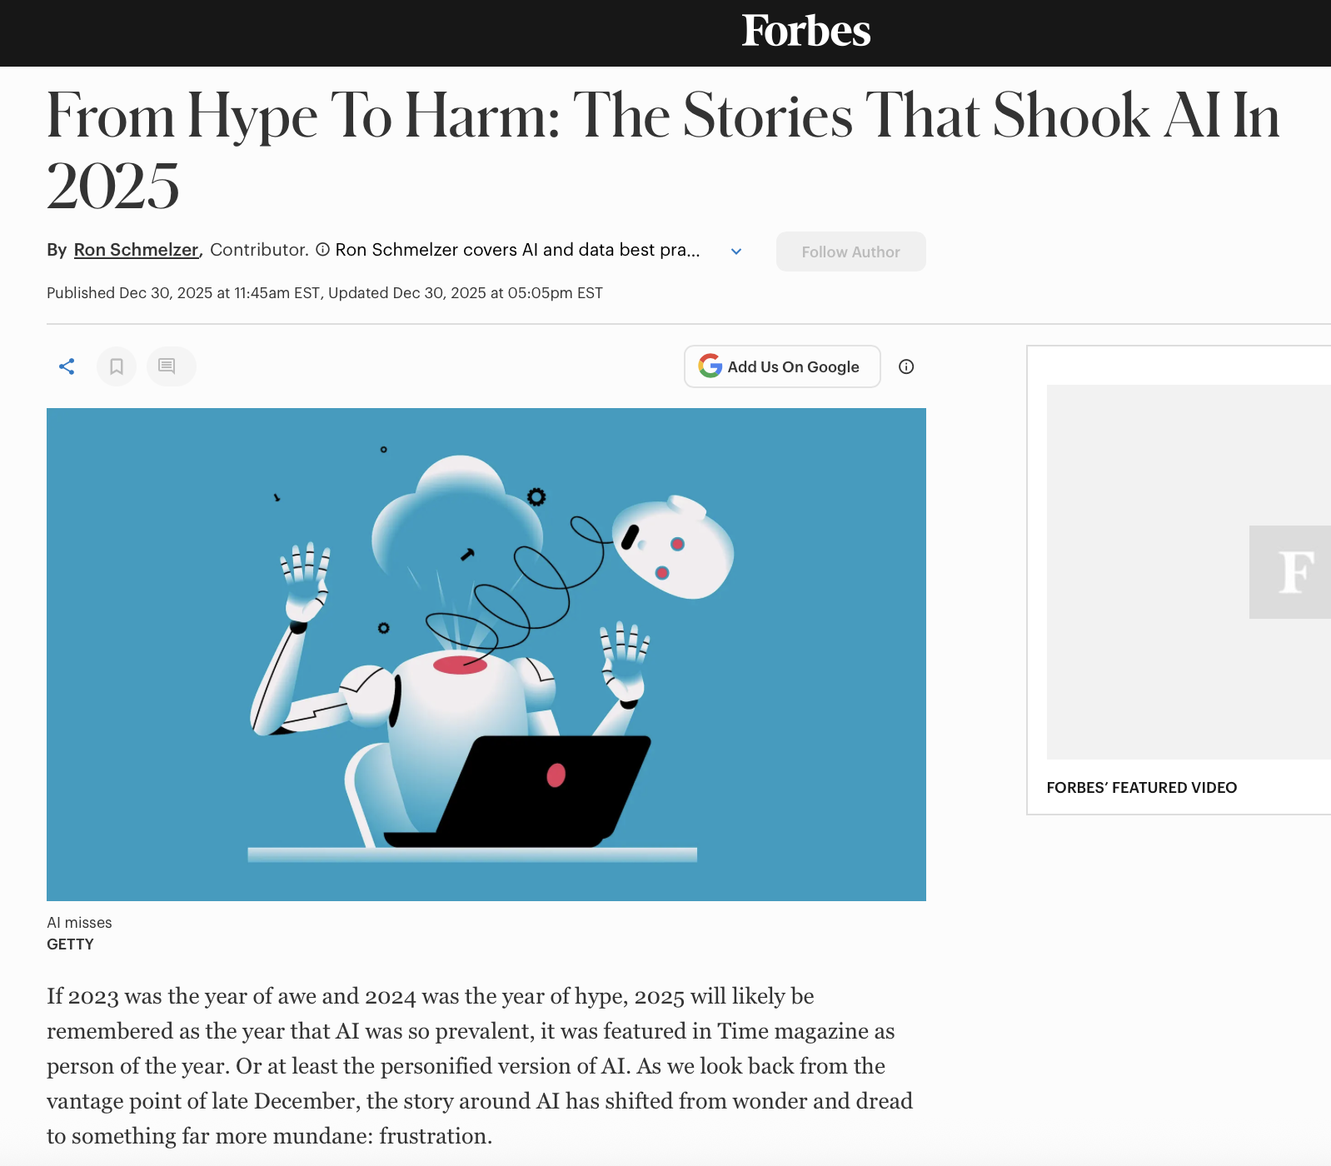
How can GenAI service us?
What should we make of the hype? Of the despair?
Source: Schmelzer, R. (2025). From hype to harm: The stories that shook AI in 2025: https://www.forbes.com/sites/ronschmelzer/2025/12/30/from-hype-to-harm-a-retrospective-on-ais-biggest-misses-of-2025/

Slide 9
A political economy framework
Political economy entails “a concern with
how wealth was generated in production,
with the role of classes in the genesis of wealth, and
with the role of the state in relation to the different classes.”
-Eric Wolf, 2010 [1982], Europe and the People Without History, p. 20-21

Slide 10
A political economy framework
Political economy entails “a concern with
how wealth was generated in production,
with the role of classes in the genesis of wealth, and
with the role of the state in relation to the different classes.”
-Eric Wolf, 2010 [1982], Europe and the People Without History, p. 20-21
To understand how our world is organized:
We have to look at the material relationships of production
Examine phenomena in historically-grounded and geographically-specific contexts
Political economy entails “a concern with
how wealth was generated in production,
with the role of classes in the genesis of wealth, and
with the role of the state in relation to the different classes.”
-Eric Wolf, 2010 [1982], Europe and the People Without History, p. 20-21

Slide 11
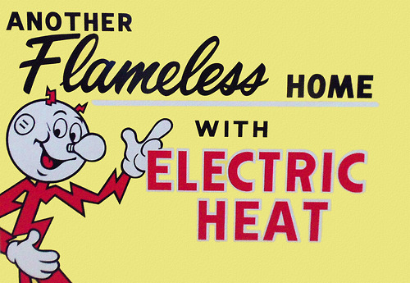

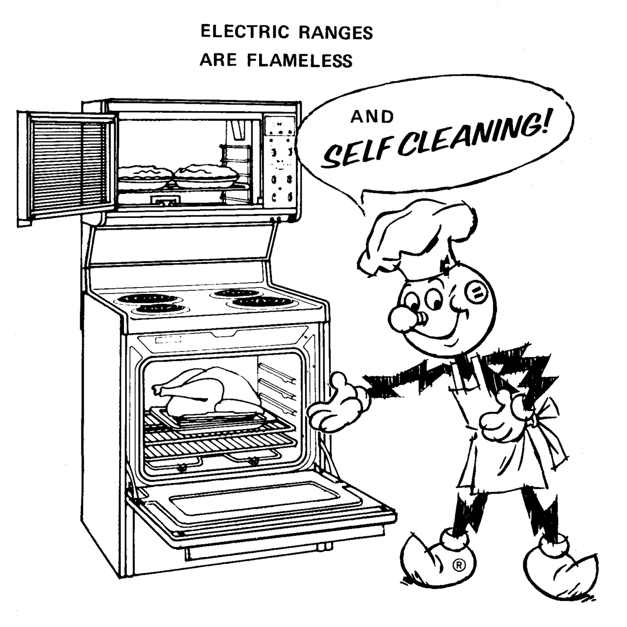

Post-WWII: Electricity companies creating & shaping consumers through advertising discourse, & with the help of government
Source: Washington State Department of Archeology and Historic Preservation (2026). Live Better Electrically: The gold medallion electric home campaign.” https://dahp.wa.gov/live-better-electrically-the-gold-medallion-electric-home-campaign

Slide 12
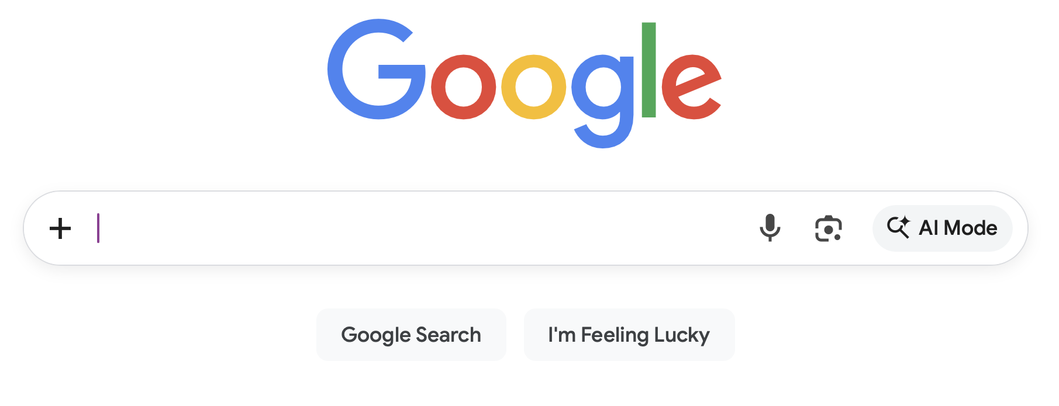
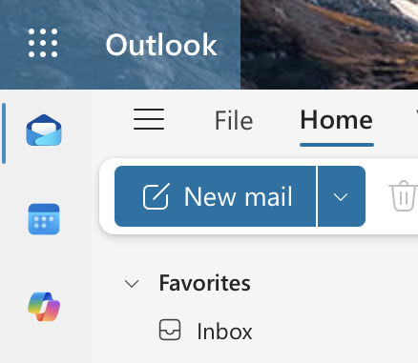
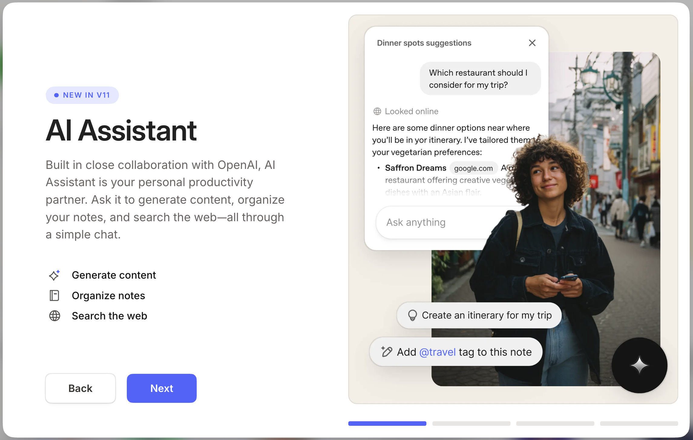
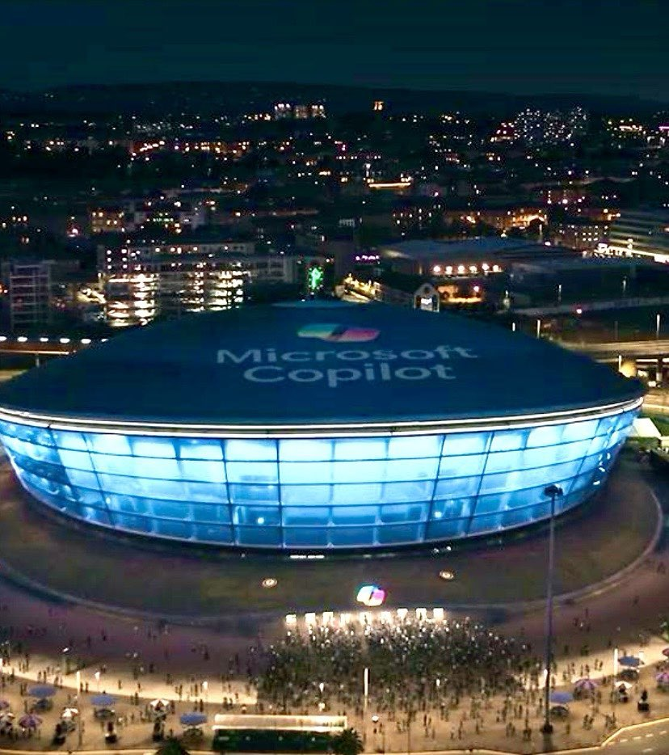
Today: GenAI companies creating & shaping consumers through forcing AI features into products & media discourse, & with the help of government

Slide 13
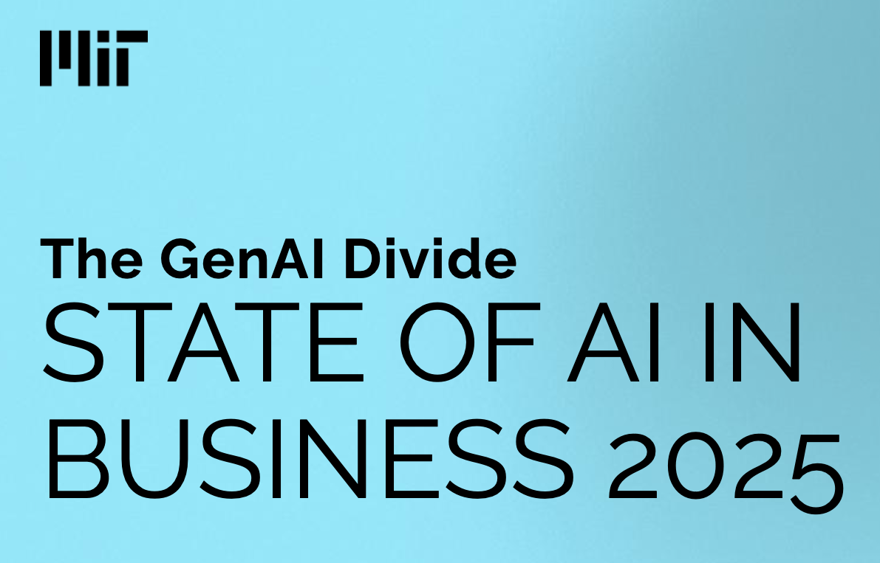
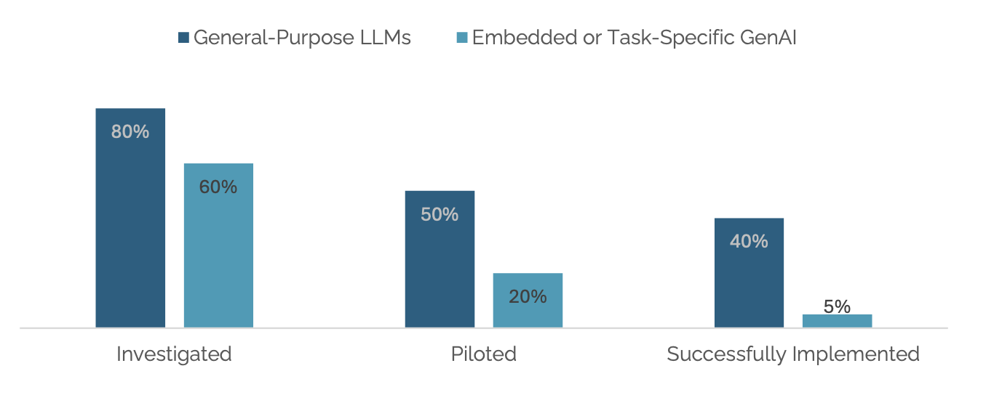
MIT business report finds very low enterprise implementation of GenAI tools
GenAI tools are built for enterprise customers across various industries (high sales volume)
After pilots, most enterprise customers reject these tools. Only 5% see GenAI tools translating into increased profits
There is a high adoption of consumer-grade tools; but successful implementation of enterprise tools is very low, leading to low revenue for GenAI companies
Source: Challapally et al. (2025). The GenAI Divide: State of AI in Business 2025. MIT NANDA Project.

Slide 14
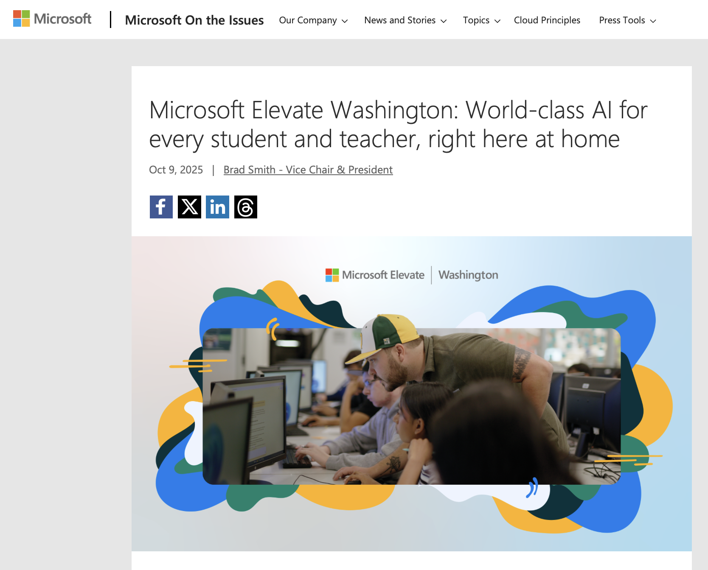
Microsoft lobbies Olympia to implement GenAI in public education (K-12, college)
Source: Smith, B. (2025, Oct. 9). Microsoft Elevate Washington: World-class AI for every student and teacher, right here at home. Microsoft. https://www.microsoft.com/en-us/elevate

Slide 15
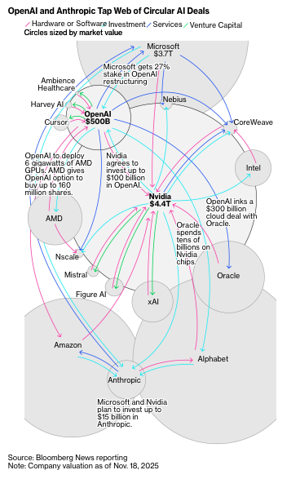
So far, there is a big gap between investments and revenue
U.S. GenAI companies are in deep debt
2023-2025: ~$700 billion tech investments into large language models (LLMs) and infrastructures
vs.
2023: $1 billion revenue from end user licenses
2024: $4 billion revenue from end user licenses
Media and academia have been reporting GenAI failures in law, education, wellness, and software development
Even if GenAI tools improve, not all the major U.S. GenAI companies will make returns on their investment, therefore they be devalued
Sources: Fiegerman, S. & Reinicke, C. (2025, Nov. 24). Why fears of a trillion-dollar AI bubble are growing. Bloomberg. https://www.bloomberg.com/news/articles/2025-11-24/why-ai-bubble-concerns-loom-as-openai-microsoft-meta-ramp-up-spending; McNamee, R. (2025, Sept. 24). AI investors are in for a rude awakening. The Guardian. https://www.theguardian.com/commentisfree/2025/sep/24/ai-investors-llms

Slide 16
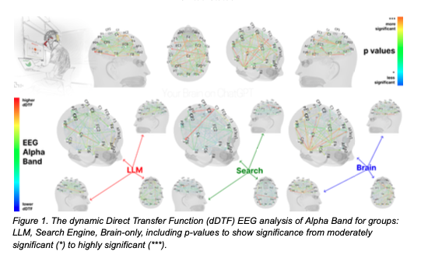
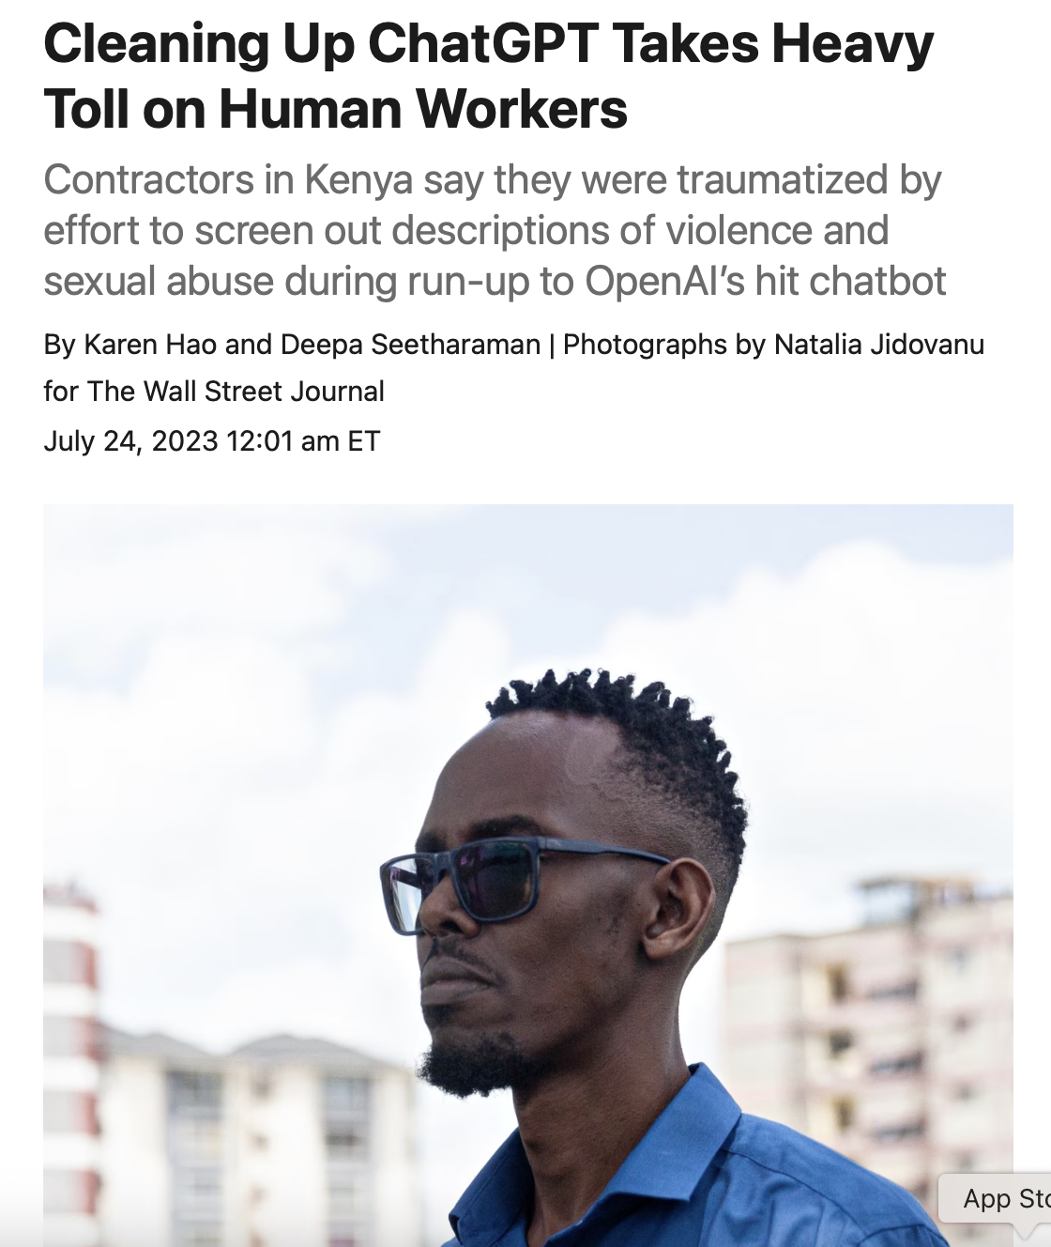
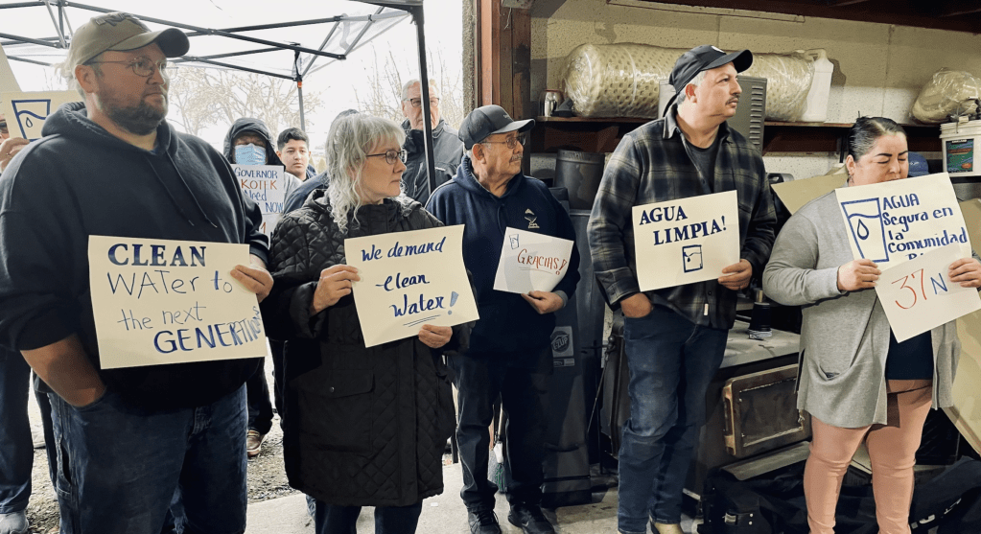
Devaluation is not just financial; it is offloaded onto people and the environment through: climate & water contamination, mental & physical illness & disease, cognitive debt, labor exploitation, trauma, etc.
Sources: Kosmyna et al. (2025). Your brain on ChatGPT: Accumulation of cognitive debt when using an AI assistant for essay writing task. MIT Pre-Print; Cooper, S. P. (2025, Nov. 24). ‘The precedent is flint’ How Oregon’s data center boom is supercharging a water crisis. Rolling Stone. https://www.rollingstone.com/culture/culture-features/data-center-water-pollution-amazon-oregon-1235466613/; Hao, K. & Seeharaman, D. (2023, July 24). Cleaning up ChatGPT takes heavy toll on human workers. Wall Street Journal. https://www.wsj.com/tech/chatgpt-openai-content-abusive-sexually-explicit-harassment-kenya-workers-on-human-workers-cf191483

Slide 17
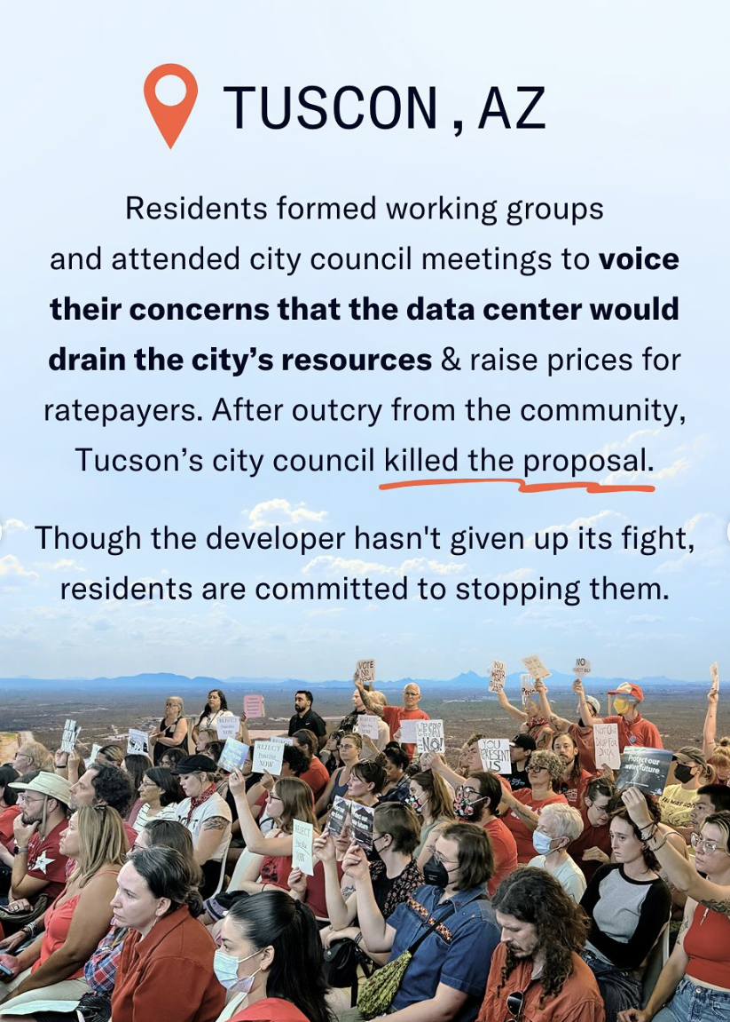
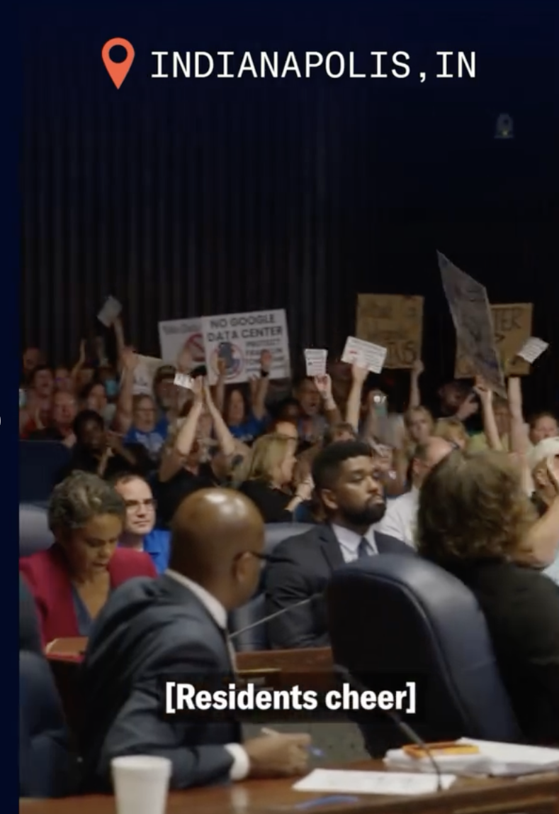
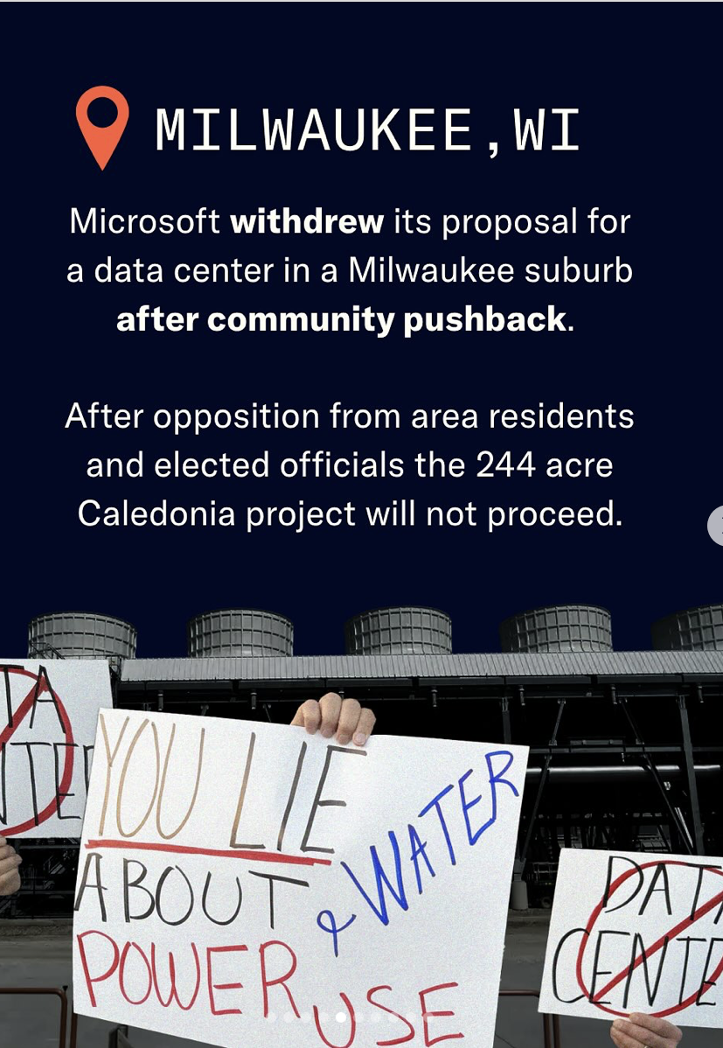
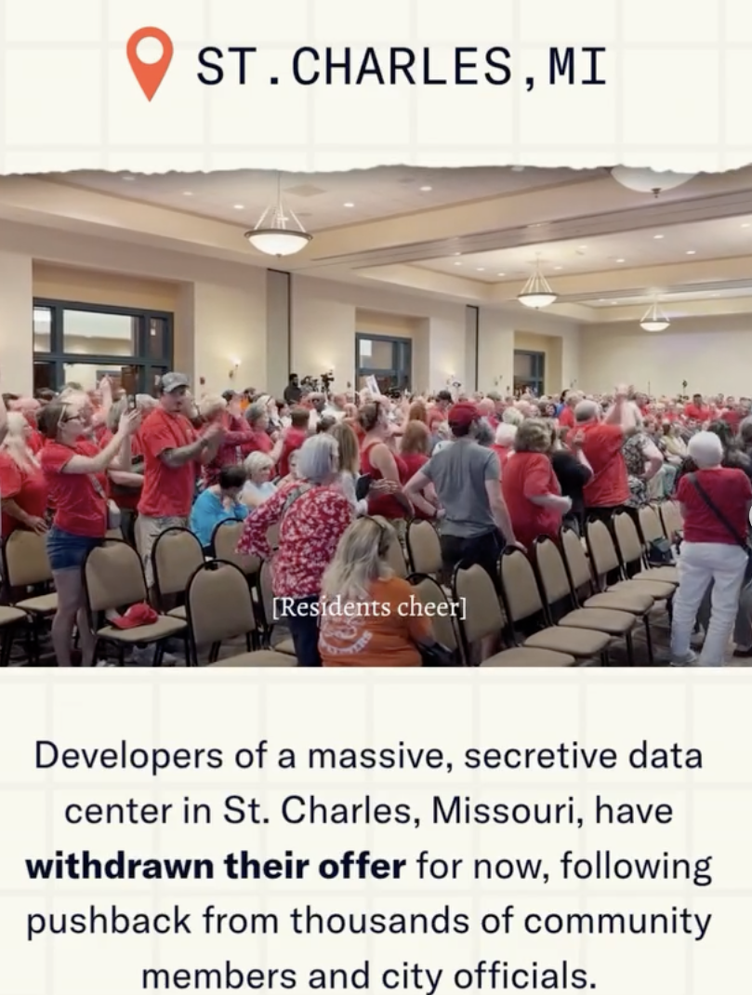
Communities across the U.S. organizing and fighting against data centers
17
Sources: More Perfect Union. (2025). I live next to Amazon’s largest data center. They’re stealing our water. https://www.youtube.com/watch?v=jjkaYyysYhA

Slide 18
How can GenAI service us?
Or is it:
How are we made to service GenAI corporations?
And who is paying for it?

Slide 19
AI and Washington’s Disinvestment in Higher Ed
Cathy Wineinger, PhD
Political Science

Slide 20
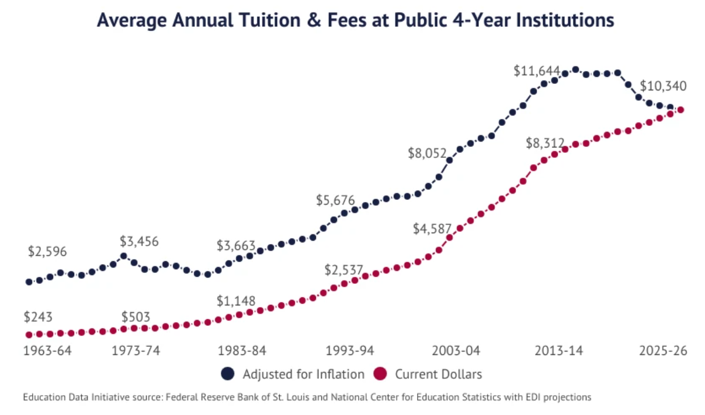

Slide 21
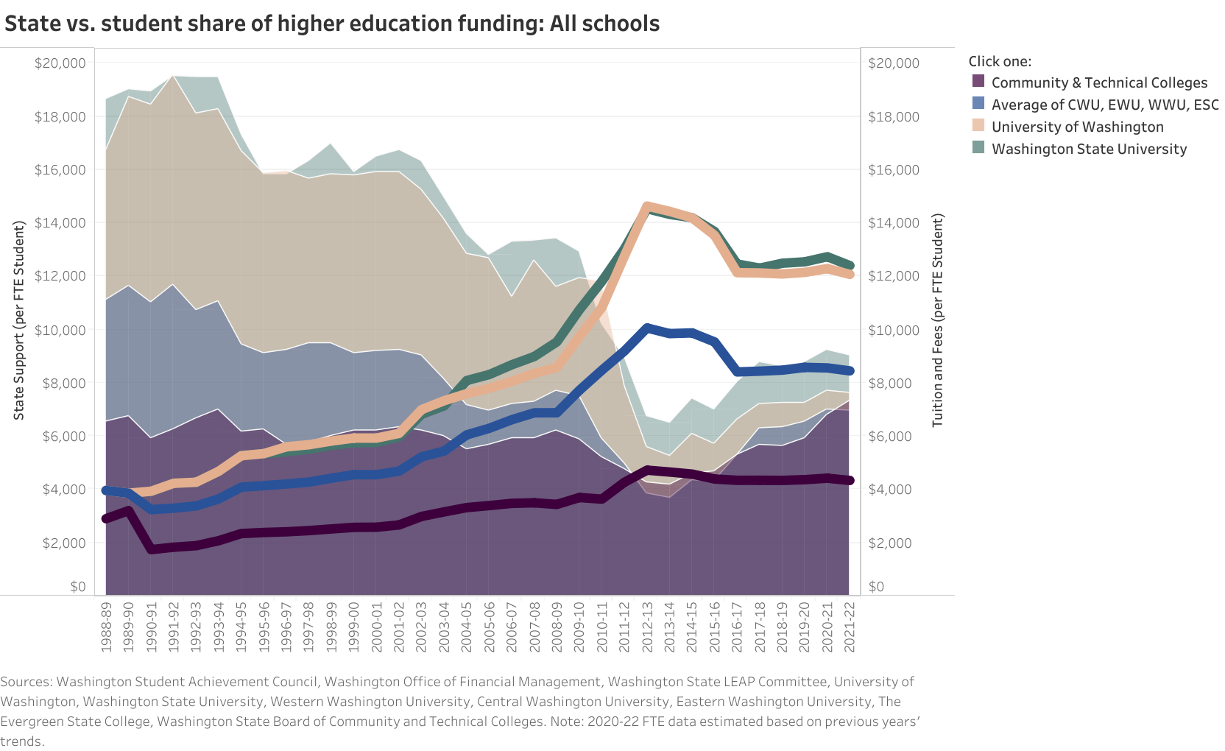

Slide 22
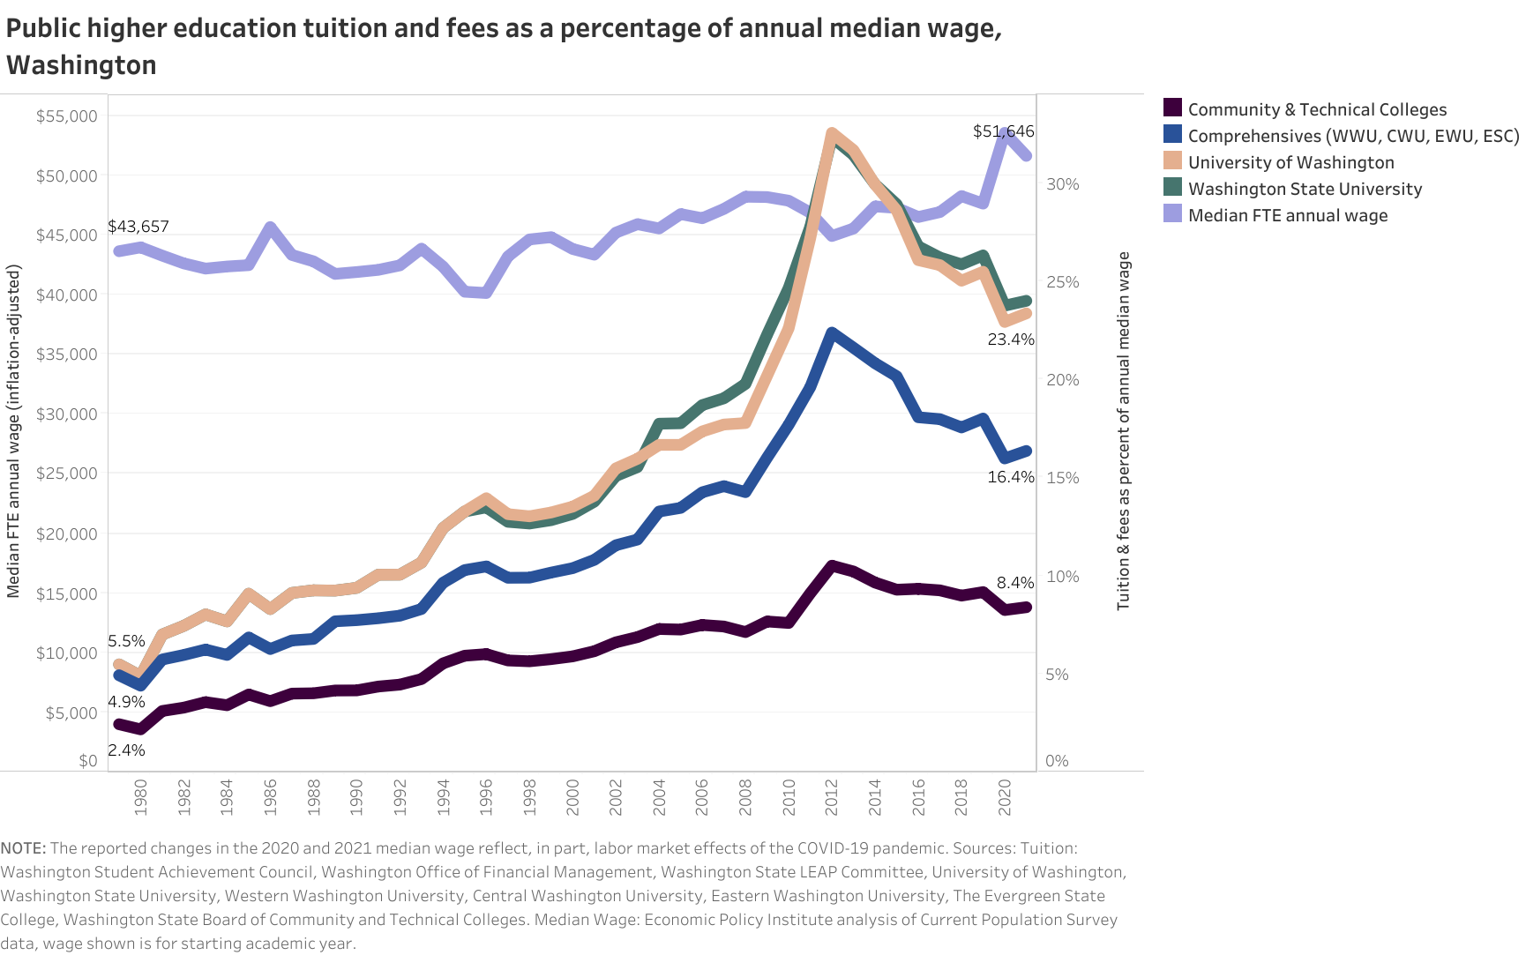

Slide 23
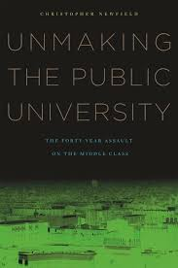
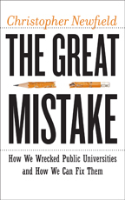
The Corporatization of Public Higher Education
The blame does not solely fall on politicians
1970s/80s: Conservative backlash to civil rights and increased access to higher education
Public universities abandoned the political fight for higher education as a public good; private research funding (patent law), marketing, etc.
“In reality, ongoing cuts are the bitter fruit of two university practices: a long-term willingness to raise tuition, which taught legislatures that universities could replace cuts with the user fee called tuition, and the failure to explain the irreplaceable role of public funding.”
–Christopher Newfield

Slide 24

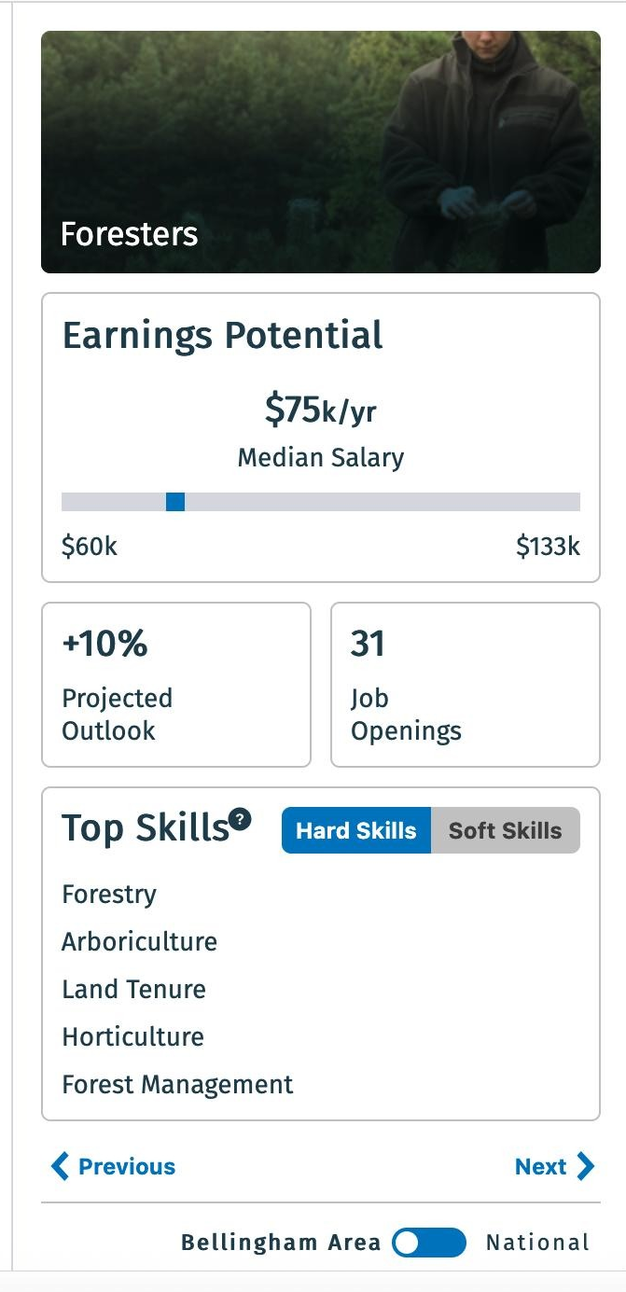
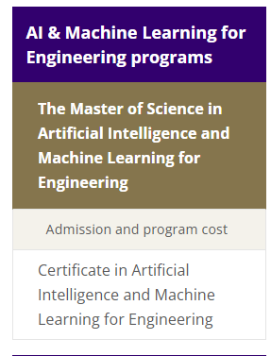

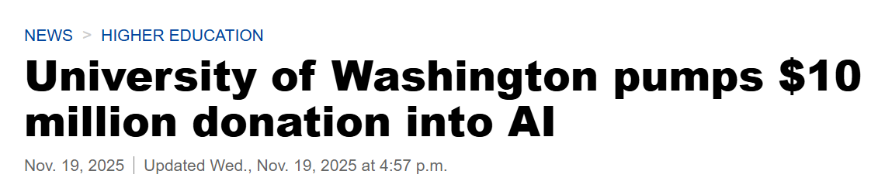

The Corporatization of Public Higer Education

Slide 25
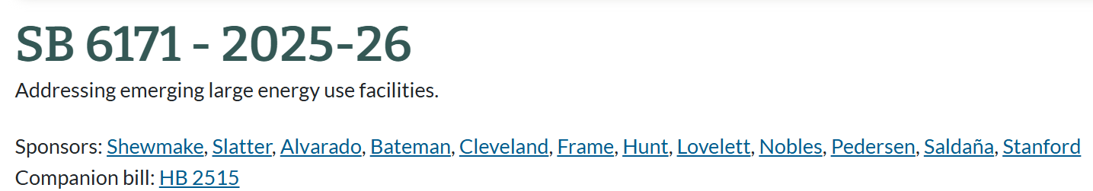
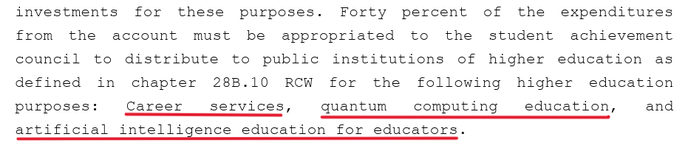
Legislating AI and Higher Education
Budget deficit
2026 Proposed Supplemental Budget: $50 million in across-the-board cuts
3% - UW and WSU
1.5% - regional universities, community and technical colleges

Slide 26
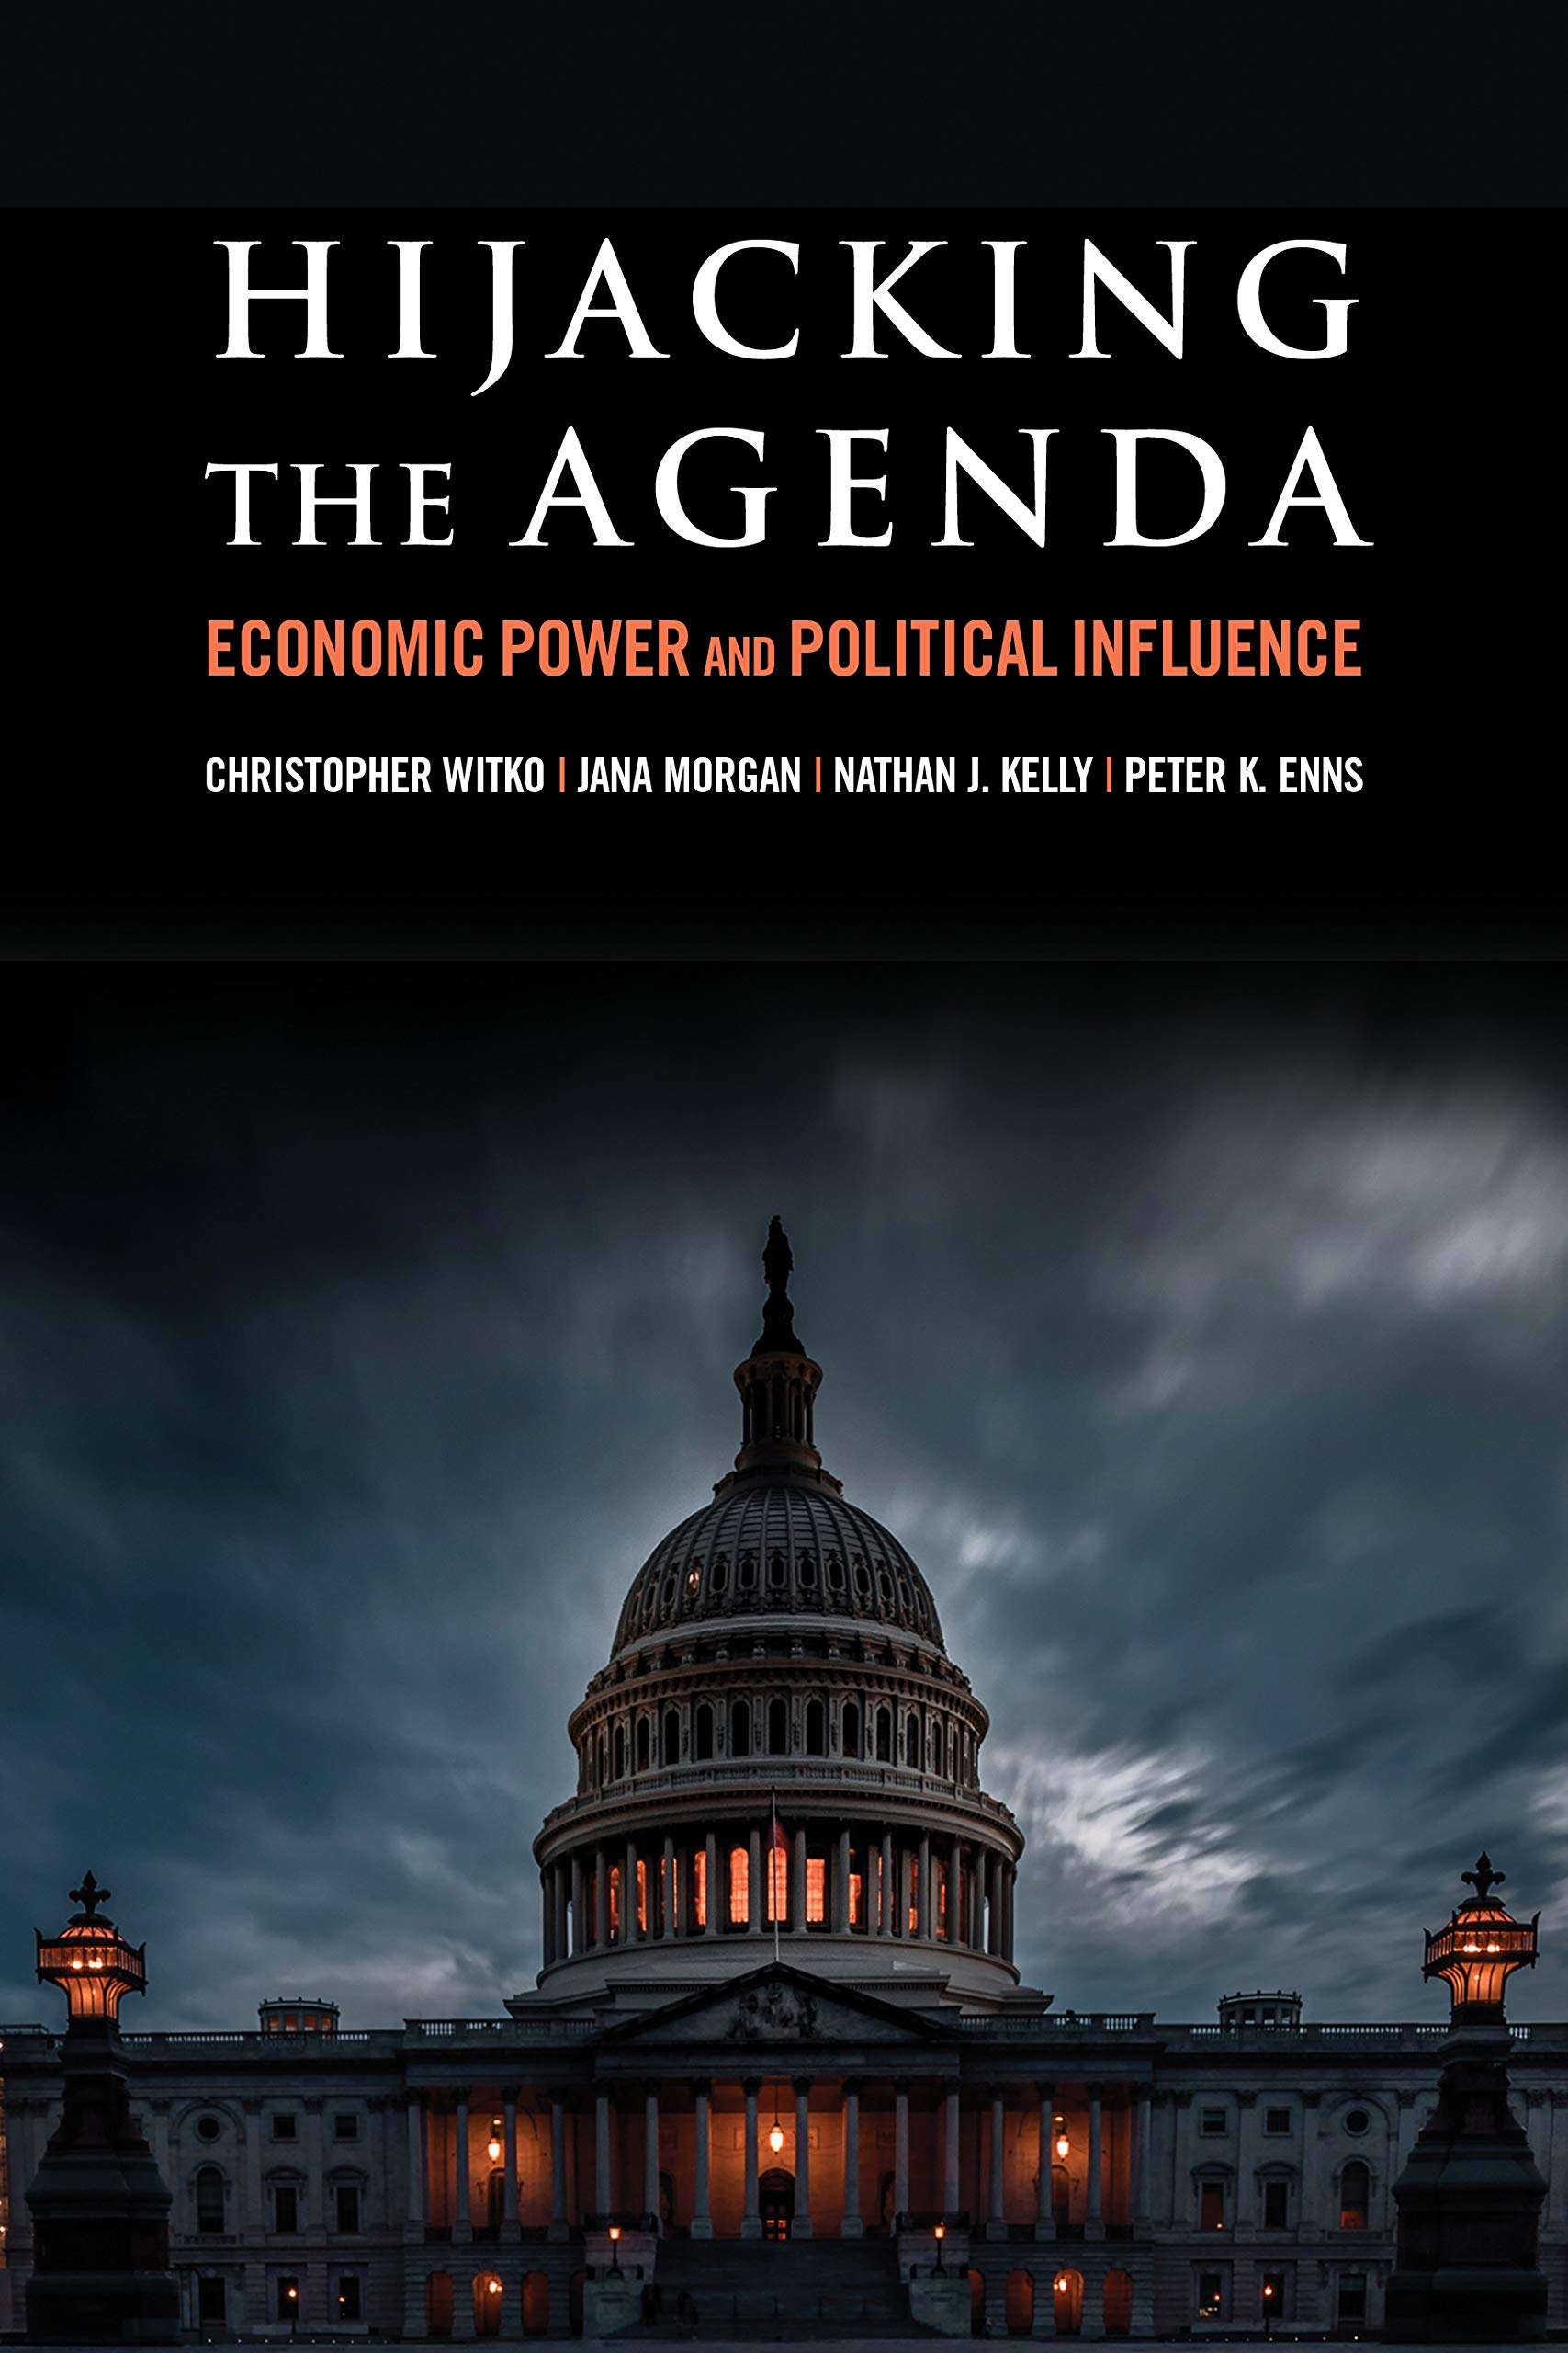
Corporate Influence in Legislatures
Kinetic power: ability to mobilize resources (corporate campaign donations, lobbying, etc.)
Structural power: position in the economy (policymakers perceive business groups as central to the performance of the economy)

Slide 27
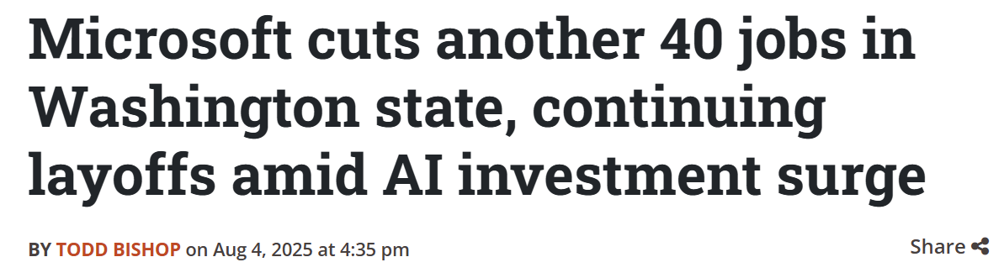
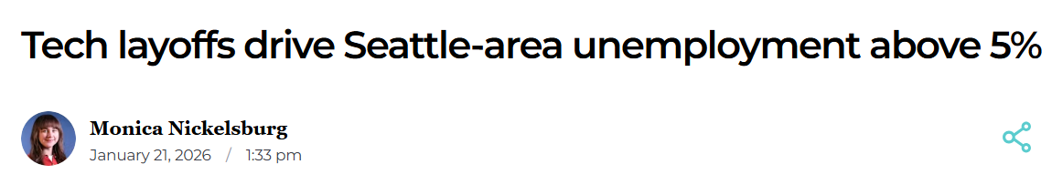
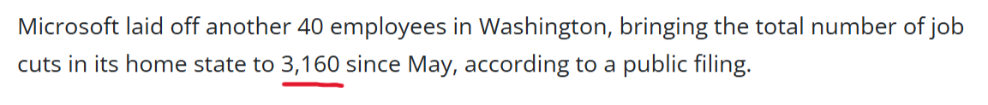

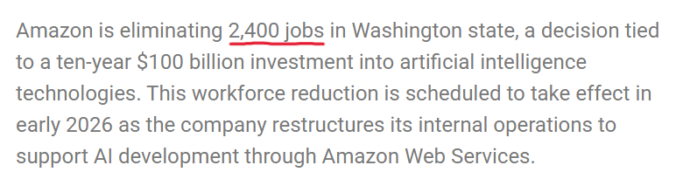

Slide 28

Breaking the Cycle, Changing the Narrative: Whatcom Crib Through College Coalition
A coalition of educators, parents, students, labor unions, and community members in Whatcom County fighting for free, quality education from crib through college.
We believe that education is a human right and a public good
We reject corporate partners and the privatization of education

Slide 29
Q & A
Share initial reactions with neighbors first (2 min), then share to the group.
We welcome students to ask questions first, then will open the floor to faculty and staff next.
Please share your questions (not comments) for the presenters.

Slide 30
Please stay for conversation and snacks!
Next CALC event: Winter Town Hall on A.I. Industry and Environmental Impacts on Monday, March 2 at 4PM in Fraser Hall 101
For Hack-a-thon information or to apply for a student organizer job, email Claudia Johnson (john567@wwu.edu)
To join the CALC list-serv and receive info + updates, email Aspen Clark (aspen.clark@wwu.edu)

